Slide 1

Making this resource work for you
Prior to teaching this lesson, please refer to the ‘Unit Overview and Planning Document’.
Further guidance on planning Science Mastery lessons can be found in the detailed planning guidance document.
Refer to the ‘notes’ section on each slide for useful information, including suggested expositions, pedagogical content knowledge, suggested questions, answers and more. Consider using presenter mode so you can see this guidance throughout the lesson.
The introduction slides can be adapted to suit your teaching style and the needs of your class.
Before the lesson, adapt the fix-it slide to address any misconceptions identified in the previous lesson’s exit ticket.
Choose from the suggested activities to suit your class. The intention is not that you complete all of these, but that you select those which ones are most appropriate for your students. It may be appropriate to further adapt activities for your students.
These lessons are designed to occupy approximately 1 hour. To adapt for a shorter or longer lesson duration we advise you to adapt the activity section accordingly.
Please consider using the final slide to send feedback about this lesson or examples of PowerPoints that you have adapted to our design team. Your feedback is used to improve Science Mastery for all of our teachers and students. We appreciate all suggestions and comments.
Thank you for reading!
The Science Mastery Team

Slide 2

Prior Knowledge Review
Answer the questions below:
State the chemical symbol for carbon.
Carbon has an atomic number of 6. State its electron configuration.
State the type of bonding found in water.
Give an example of a giant covalent network.
Define a compound.
C
2,4
Covalent
Diamond, graphite, silicon dioxide
Two or more elements chemically bonded together

Slide 3
Prior Knowledge Review
Do Now:
State the chemical symbol for carbon.
Carbon has an atomic number of 6. State its electron configuration.
State the type of bonding found in water.
Give an example of a giant covalent network.
Define a compound.
Drill:
State the chemical formula for carbon dioxide.
Name the type of bonding found in carbon dioxide.
Draw a dot and cross diagram to show the bonding in a molecule of carbon dioxide.
Notes:
Drill answers:
Plants → voles → owls
Owls
Voles

Slide 4
Prior Knowledge Review
Read Now:
Covalent bonding takes place between non-metal atoms, where they share electrons to achieve a full outer shell and stable electron arrangement. Some covalent structures are molecules, which are small groups of non-metal atoms held together by strong covalent bonds. Some molecules can actually be very large, including one of the largest naturally-occurring molecules: DNA. Covalent bonding can also be found in giant covalent structures, such as diamond and graphite, which involve huge numbers of atoms covalently bonded to other atoms.
Identify the type of elements between which covalent bonds are formed.
Explain why atoms make bonds.
Explain what is meant by a stable electron arrangement.
Define a molecule.
Give an example of a giant covalent structure.
Notes:
Answers:
Non-metals
To achieve a stable electron arrangement/full outer shell
A full outer shell
A group of non-metal atoms covalently bonded together.
Diamond, graphite

Slide 5


C5.1.1
12/09/2025
Prior Knowledge Review
C5.1.1 Prior Knowledge Review
C5.1.2 Crude Oil and Hydrocarbons
C5.1.3 Fractional Distillation
C5.1.4 Combustion of Hydrocarbons
C5.1.5 Cracking
C5.1.6 Taking it Further: Alkenes
C5.1.7 Taking it Further: Alcohols
C5.1.8 Taking it Further: Producing Ethanol by Fermentation
C5.1.9 Taking it Further: Producing Ethanol from Ethene
C5.1.10 Taking it Further: Carboxylic Acids
C5.1.11 Taking it Further: Esters
C5.1.12 Polymers
C5.1.13 Taking it Further: Addition Polymerisation
C5.1.14 Taking it Further: Condensation Polymerisation
C5.1.15 Taking it Further: Naturally Occurring Polymers
Notes:
Big Idea: Structure Determines Properties
This is the sixth unit that students will study under the big idea ‘Structure Determines Properties’. Students should have an understanding of the different types of bonding, so covalent bonding will be the focus of this review lesson.
Suggested Hook:
How many different molecules can you name? What is a molecule?

Slide 6

Following this lesson, students will be able to:
Identify different types of bonding from chemical formulae
Describe what happens when a covalent bond is formed
Use diagrams to show covalent bonding
Key Words:
covalent
molecule
electronic configuration
dot and cross diagram
Notes:
Guidance:
See unit overview document and planning guidance to see how these objectives are typically assessed at GCSE, including examples of what students should be able to do following this lesson.
Planning for different needs:
The learning objectives given on this slide are suggested based on the most common requirements for exams, however they can be adapted based on the needs of different classes.
For best practice, the unit preparation booklet should be used to determine the appropriate focus of lessons within the unit.
While it is not possible to explicitly split content into levelled grades, we recommend that lesson objectives can be classified as critical, core or stretch.
Critical: the content or skill is essential for all students to be able to progress.
Core: the content or skill is important for students to progress, but other opportunities may be available to revisit it.
Stretch: the content or skill may not be essential for all students but is important for students aiming for the highest grades.
Key skill: this is a crucial skill being developed in this unit as part of the skill mapping
C5.1.1 Lesson Objectives:
Critical: Identify different types of bonding from chemical formulae
Critical: Describe what happens when a covalent bond is formed
Critical: Use diagrams to show covalent bonding

Slide 7
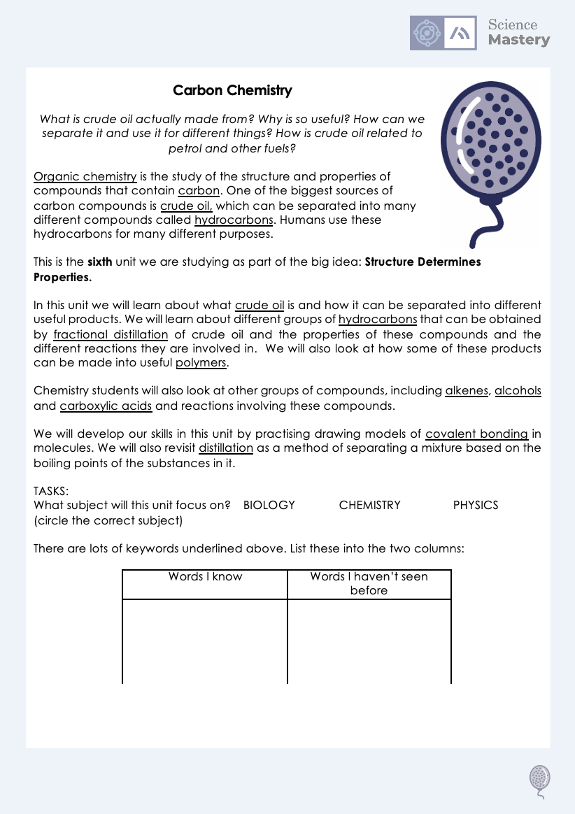
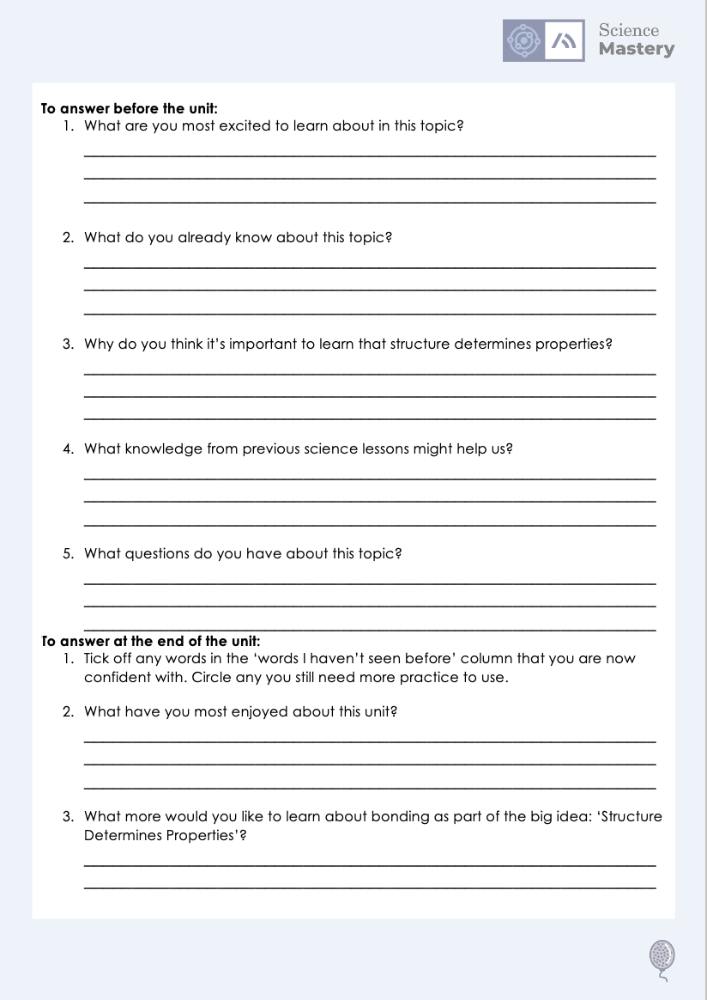
The Big Idea: Structure Determines Properties
Notes:
Purpose:. The purpose of this resource is to provide students with an overview at the beginning and end of each unit. It is designed to create a discussion about the unit prior to the sequence of lessons.
Teacher guidance:
Pupils should be directed to the C5.1 Link to Big Ideas worksheet (either in their booklet or printed).
Teachers should use guided reading techniques to read aloud with the pupils. Tier 3 vocabulary has been highlighted. (It may need to be adapted further for LPAs or pupils with different reading ages.)
Questions on the student sheet:
1. What are you most excited to learn about in this topic?
2. What do you already know about this topic?
3. What is matter?
4. Why do you think it’s important to learn that our bodies are systems?
5. What knowledge from previous science lessons might help us?
6. What questions do you have about this topic?
There are a range of ways to use this resource:
1. Display on a slide for students to read as a class. Direct students to complete the activities in their book.
2. Print off for students to stick into their book at the beginning of the unit along with their knowledge organiser. Complete as a guided reading task together. Direct students to complete the activities.
3. Have students complete as part of a booklet.
Set as a homework prior to a unit.
If you have any feedback about how this resource could be used/improved, please contact the science mastery team: sciencemastery@arkonline.org

Slide 8
This is the fix-it portion of the lesson
The fix-it is an opportunity to respond to gaps in knowledge, especially those identified by the previous lesson’s exit ticket.
The teacher should customise this slide as needed, to facilitate
reteach, explanation, demonstration or modelling of ideas and concepts that students have not yet grasped or have misunderstood.
practise answering specific questions or of key skills.
redrafting or improving previous work.
Notes:
Purpose: Fix-it slide to spend time on any gaps identified in previous learning from pre-unit quiz.

Slide 9
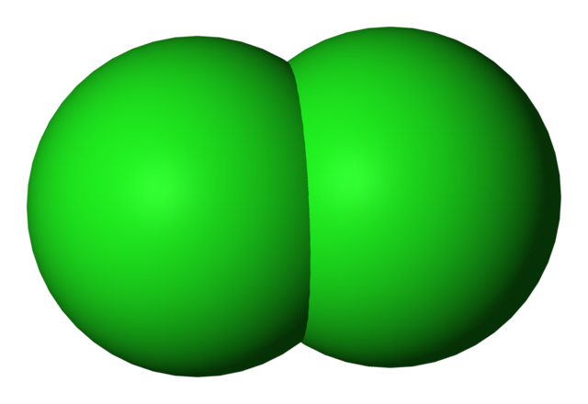
Covalent
Word:
Comes from:
Co-
-valent
‘together’
‘partnered’
‘relating to the valence shell’
Definition:
Covalent bonding occurs where two or more non-metal atoms share pairs of electrons in order to achieve a stable electronic configuration
×
H-H
×
H H
Hydrogen atom
Hydrogen atom
Hydrogen molecule (H₂)
×
Notes:
Exposition type: Explanation
Suggested teacher exposition:
Who can remember the two kinds of covalent substances? Simple and giant covalent.
Today we will be looking more closely at covalent bonding. Covalent bonds are the bonds that hold the molecules together in covalent substances (just like ionic substances are held together by ionic bonds).
If we look at the word covalent, there’s a clue as to how this bonding comes about.
Co- means together or partnered, like co-parenting, co-operating, co-captain.
-valent means it has to do with the valence shell of an atom – the outer shell. This is where the electrons are that are involved in bonding.
So, covalent bonding occurs where two or more non-metal atoms share pairs of electrons in order to achieve a stable electronic configuration.
Let’s break this definition down.
Covalent bonding occurs between non-metal atoms. What kind of atoms did ionic bonding occur between? A metal and a non-metal. What about metallic bonding? A metal and another metal. Covalent is only between non-metals. So if we see a compound that is only made of non-metal atoms then it must contain covalent bonding.
Ok, next it says that in covalent bonding the atoms share pairs of electrons. How is that different to ionic bonding? In ionic bonding the atoms transferred, or moved, electrons from one atom to another. One atom lost the electrons and one gained them. However, in covalent bonding they both use the electrons! They can share a pair.
Finally, it says that the atoms are doing this in order to achieve a stable electronic configuration. Is this the same as ionic bonding? Yes! Atoms will have full outer shells at the end of the bonding.
Because it is only electrons on the outer shell that are involved in covalent bonding, we will only draw the outer shells.
Let’s take a look at a simple example: hydrogen gas, H2. Hydrogen atoms look like this. We know they just have on electron on their shell. How many more electrons does each atom need? 1. Both hydrogen atoms need one more. They won’t transfer one electron from one atom to another, they’ll share.
We can show this in a diagram such as this, where the two circles overlap. Point how how the diagram shows that each atom now has 2 electrons on their outer shell by tracing your finger around the circle and counting the number of electrons you pass on your way around. Note for students how we have kept the original dot and cross so we can see which atom each electron came from.
Every time two atoms share a pair of electrons, this is one covalent bond. Covalent bonds are very strong.
We can represent these bonds in a number of different ways, and you will come across these representations in various activities an textbooks.
In this first representation, the single line between the two H’s represents one covalent bond (one shared pair of electrons)
In this second representation, its similar to the previous one, but here we have replaced the line with a little dot and cross, like a simple version of the big dot-and-cross diagram.
Finally, we have a 3D model of this molecule that looks like a balloon, or sometimes we can show these as a ball and stick model. Dual code the ball and stick version of this molecule on the board.
Additional information for teachers:
Molymods are useful to be able to show a 3D version of the molecule as you explain. Students needs to be aware that these diagrams are 2 dimensional representations of 3D ‘objects’.
This lesson has a number of different covalent compounds that are worked through to see the dot and cross bonding diagram and various representations. Some classes will be able to use the principals shared in the first couple of examples to deduce the dot and cross diagrams for other compounds themselves, so it won’t be necessary to walk the class through each example in its entirety. All of the diagrams that students could be asked to draw are included in the introduction section here for completeness.
Image source: Public Domain via Wikimedia Commons

Slide 10
Covalent bonding in chlorine (Cl₂)
We can also represent this molecule like:
Cl-Cl
×
×
×
×
×
×
×
×
×
Cl
Cl
×
Chlorine atom
2, 8, 7
Chlorine atom
2, 8, 7
×
×
×
×
×
×
×
×
×
×
×
Chlorine molecule
Cl₂
Notes:
Exposition type: Explanation
Suggested teacher exposition:
Let’s take a look at another example: chlorine gas, Cl₂. Chlorine atoms look like this. We know they have 7 electrons on their outer shell, because chlorine is group 7of the Periodic Table. How many more electrons does each atom need? 1.
Both chlorine atoms need one more electron to make a full outer shell of 8. They won’t transfer one electron from one atom to another, they’ll share. If each chlorine atom shares one of its electrons they’ll both have enough for a stable electronic configuration (a full outer shell).
We can show this in a diagram such as this, where the two circles overlap. Point how how the diagram shows that each atom now has the maximum number of electrons on their outer shell by tracing your finger around the circle and counting the number of electrons you pass on your way around. Note for students how we have kept the original dot and cross so we can see which atom each electron came from. You could challenge more able students to try to come up with this dot-and-cross diagram by themselves.
Every time two atoms share a pair of electrons, this is one covalent bond. Covalent bonds are very strong. Covalent bonds are strong because both nuclei are strongly attracted to the shared pair of electrons in the covalent bond
We can represent these bonds in a number of different ways, and you will come across these representations in various activities an textbooks.
In this first representation, the single line between the two Cl’s represents one covalent bond (one shared pair of electrons)
In this second representation, its similar to the previous one, but here we have replaced the line with a little dot and cross, like a simple version of the big dot-and-cross diagram.
Finally, we have a 3D model of this molecule that looks like a balloon, or sometimes we can show these as a ball and stick model.
Dual code the ball and stick version of this molecule on the board.
Show the class a molymod version of the molecule (or ask them to build one) so they can see the shape in 3D.
This molecule consists of 2 chlorine atoms, so the chemical formula for the molecule is Cl₂
Image source: Public Domain via Wikimedia Commons

Slide 11
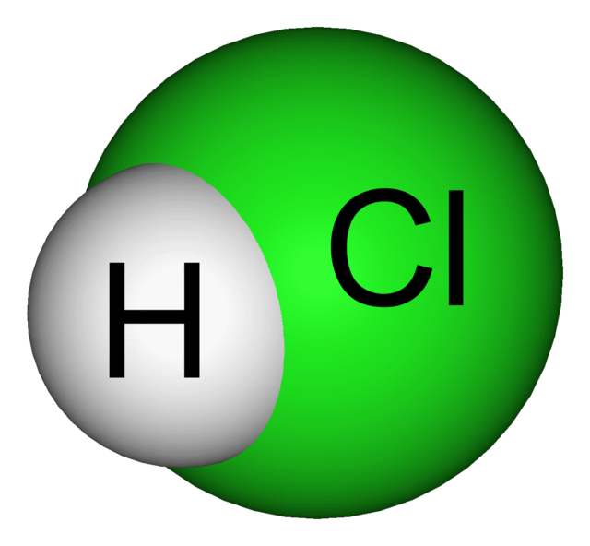
Covalent bonding in hydrogen chloride (HCl)
We can also represent this molecule like:
×
H-Cl
×
×
×
×
×
×
×
×
H
Cl
×
Hydrogen atom
1
Chlorine atom
2, 8, 7
×
×
×
×
×
×
×
Hydrogen chloride molecule
HCl
×
×
×
×
Notes:
Exposition type: Explanation
Suggested teacher exposition:
Let’s take a look at another example. This time we have two different atoms: hydrogen and chlorine, which react to form hydrogen chloride, HCl. Hydrogen atoms look like this. They have one electron, and they need another for a stable electronic configuration. Chlorine atoms look like this. We know they have 7 electrons on their outer shell, because chlorine is group 7of the Periodic Table. How many more electrons does this atom need? 1.
Both atoms need one more electron to make a full outer shell. They won’t transfer one electron from one atom to another, they’ll share. If each atom shares one of its electrons they’ll both have enough for a stable electronic configuration (a full outer shell).
We can show this in a diagram such as this, where the two circles overlap. Point how how the diagram shows that each atom now has the maximum number of electrons on their outer shell by tracing your finger around the circle and counting the number of electrons you pass on your way around. Count the number of dots to see that they are the same as in the atom diagram. Do the same for the crosses. Note for students how we have kept the original dot and cross so we can see which atom each electron came from. You could challenge more able students to try to come up with this dot-and-cross diagram by themselves.
Every time two atoms share a pair of electrons, this is one covalent bond. Covalent bonds are very strong. Covalent bonds are strong because both nuclei are strongly attracted to the shared pair of electrons in the covalent bond
We can represent these bonds in a number of different ways, and you will come across these representations in various activities an textbooks.
In this first representation, the single line between the two element symbols represents one covalent bond (one shared pair of electrons)
In this second representation, its similar to the previous one, but here we have replaced the line with a little dot and cross, like a simple version of the big dot-and-cross diagram.
Finally, we have a 3D model of this molecule that looks like a balloon, or sometimes we can show these as a ball and stick model.
Dual code the ball and stick version of this molecule on the board.
Show the class a molymod version of the molecule (or ask them to build one) so they can see the shape in 3D.
This molecule consists of 1 hydrogen atom and 1 chlorine atom, so the chemical formula for the molecule is HCl
Image source: Public Domain via Wikimedia Commons

Slide 12
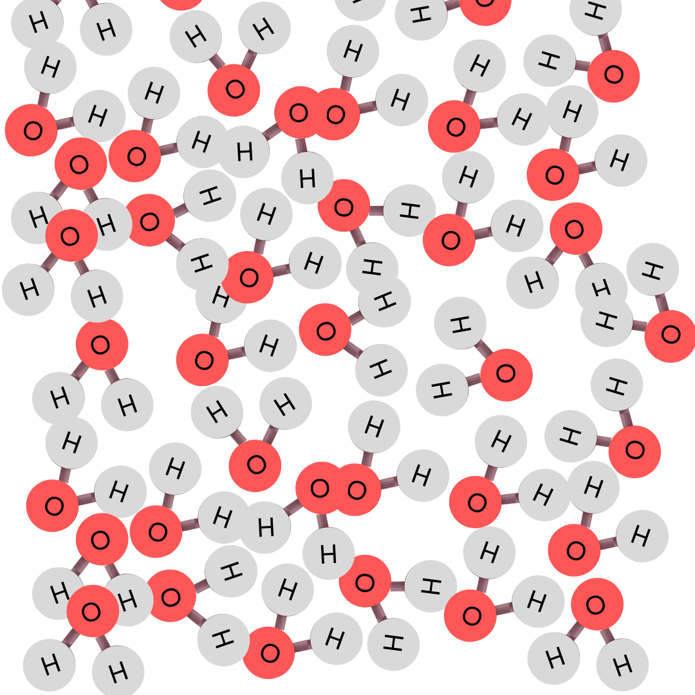
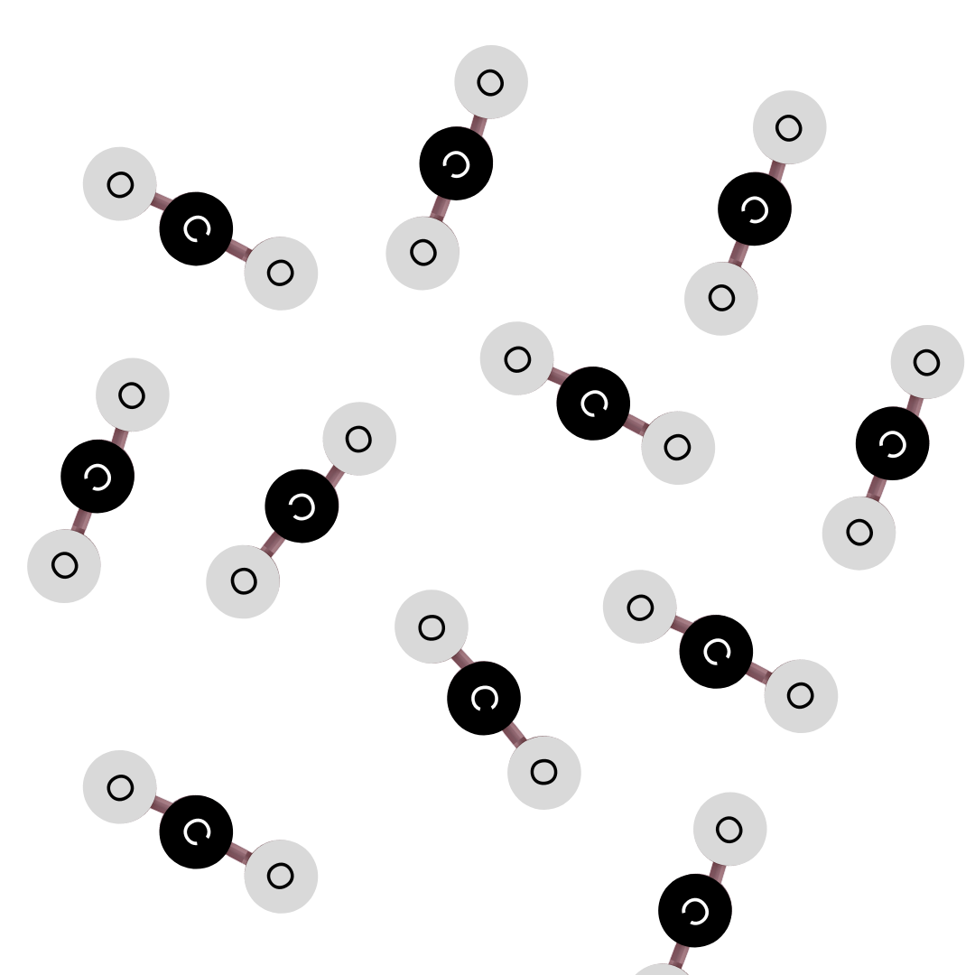
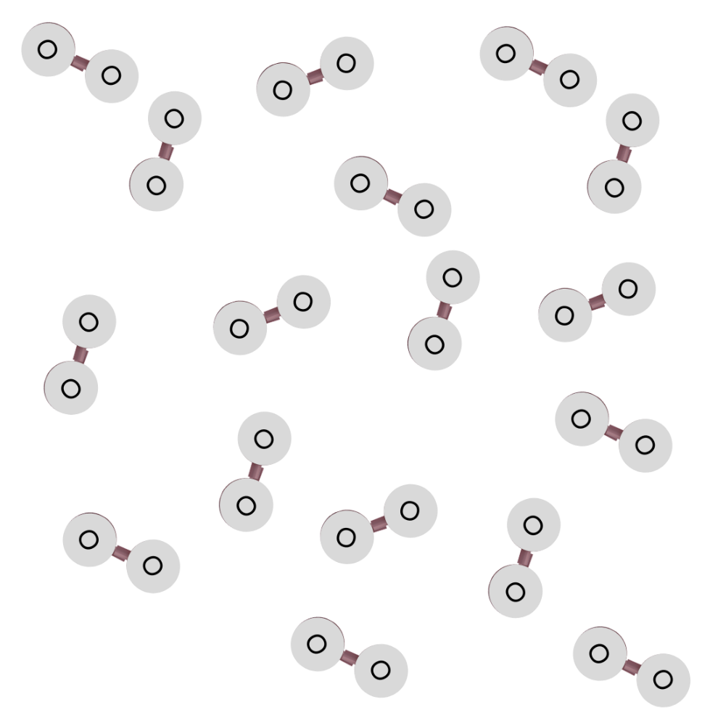
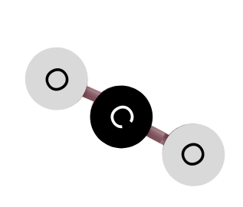
The structure of simple covalent substances
Examples of simple covalent substances include
water (H₂O)
carbon dioxide (CO₂)
oxygen gas (O₂)
Simple covalent substances consist of many small molecules
Strong covalent bonds hold the atoms in a molecule together
Weak intermolecular forces act between the molecules
Notes:
Model teacher exposition:
We will come back to giant covalent substances later in this unit. For now let’s focus on simple covalent substances.
We know that simple covalent substances
have low melting and boiling points
are liquids and gases at room temperature
do not conduct electricity
Let’s take a look at the structure of these substances and see if we it tells us more about why they all share those properties.
Lots of the substances you will be very familiar with already are simple covalent substances. Examples of these include:
water display water image
carbon dioxide (CO₂) display carbon dioxide image
and oxygen gas (O₂) display carbon dioxide image
Do you remember back in year 7, you learned to draw particle diagrams for solids liquids and gases? Well these images here are essentially showing you the same thing. Except, if you look at the liquid water, for example, instead of lots of simple circles making up your particle diagram dual code the year 7 version of this particle diagram on the board to make the link back
, you’ve got lots of simple molecules. See each one has 2 H’s and 1 O – for H2O. Just like in your liquid particle diagram these molecules are touching each other, close together, but not so tightly packed that they can’t move, like in a solid. They can flow past each other.
Looking at the other two particle diagrams, carbon dioxide and oxygen gas, these both depict gases, so they might remind you of the particle diagrams you drew in year 7 of gases, where each little circle didn’t touch its neighbours, because they can all move freely and fill the container. dual code the year 7 version of this particle diagram on the board to make the link back
Well you probably already knew that the formulae for oxygen gas and carbon dioxide were O2 and CO2, so it make more sense now that each of those little circles that you drew back in year 7 represented one molecule of each of these gases.
So, simple covalent substances consist of many small molecules.
Water consists of many molecules of H₂O
Oxygen gas consists of many molecules of O_{2.} These are diatomic molecules. Who can remember what a diatomic element means from year 9? An element that exists as molecules made of pairs of atoms (2 oxygens for example). Other examples are H₂, Cl₂.
Carbon dioxide gas consists of many molecules of CO₂
And many many other simple covalent substances consist of other small molecules.
Holding these molecules together, are very strong covalent bonds, which we’ll learn more about next lesson. These bonds hold the hydrogen atoms to the oxygen atom in a water molecule, and they hold the carbon atom to the oxygen atoms in CO₂.
However, in between the molecules there are just weak forces, called intermolecular forces. That means in between one carbon dioxide molecule and another carbon dioxide molecule, there are only weak (or sometimes none at all) forces holding them together. This is why most of the simple covalent substances are liquids or gases at room temperature. The intermolecular forces increase with the size of the molecules, so larger molecules have higher melting and boiling points.

Slide 13
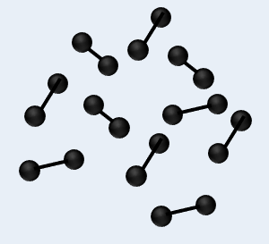
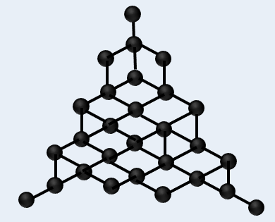
Properties of covalent substances
There are two categories of covalent substances:
simple covalent substances
giant covalent substances
have low melting and boiling points
are liquid or gas at room temperature
do not conduct electricity
have high melting and boiling points
are solid at room temperature
may conduct electricity
Look at the structure of each type of covalent substance carefully.
Which substances
will have a high melting and boiling point?
will usually be a liquid or gas at room temperature?
do not conduct electricity?
Notes:
Model teacher exposition:
So far we have looked at metallic substances and metallic bonding, ionic substances and ionic bonding, and now finally we will look at covalent substances and covalent bonding.
Let’s start with the properties of covalent substances.
There are two kinds of covalent substances: simple and giant.
Where have we heard of giant structures in the past? In metals and in giant ionic lattices.
What did we mean in those examples by a giant structure? A substance which has a repeating structure of many many atoms or ions.
This is also the same for covalent substances – they can be giant, or the opposite – they can be simple involving just a few atoms bonded together.
Look carefully at the structure of each. Let’s see if you can predict some of the properties that these substances will have by looking at the structures.
Go through each of the properties as they pop up, explaining why each relates to the structure of the substance.
Simple covalent substance have low melting and boiling points (or are liquids and gases at room temperature) because they have weak intermolecular forces of attraction between the molecules. These require little energy to overcome and melt or boil the substance.

Slide 14

Who do you agree with?
The bonding in an O₂ molecule looks like this:
The bonding in an O₂ molecule looks like this:
×
×
×
×
×
×
×
×
×
×
×
×
×
O-O
O=O
Notes:
The second answer is correct.
In the first answer, each oxygen atom has a total of 8 electrons in the valence shell which is a stable arrangement, and so students often offer this as the dot and cross diagram because it seems to be correct. However, looking at the electronic configuration of an oxygen atom, the valence shell starts off with 6 electrons. This answer suggests that the oxygen atoms start off with 7, and so they only need to share one pair.
Suggested guidance:
Talk tasks can be used in a variety of ways to suit the particular needs of the students you are teaching. Through exchanging views with others, students develop their understanding of the science beyond what could be achieved individually.
Science classrooms that successfully integrate talk have the following features:
Science talk is a regular feature of lessons and is woven into classroom activities.
Students are paired or grouped strategically by the teacher to ensure productive interaction. This might take into consideration the students’ proficiency of the English language, how encouraging they might be to peers and their attainment in the topic. It’s a good idea to consider these pairings in the class seating plan.
Students are encouraged and supported to talk, but are not forced to talk.
The teacher should take on the role of a facilitator, engaging with conversations where necessary and encouraging or steering the conversation where needed.
Students are encouraged to use the language they have to express their ideas (e.g., everyday language, imperfect English, native language), but also to incorporate science specific terminology where this is more accurate or has been taught.
6. Scientifically inaccurate ideas are not dismissed by the partner or teacher; open discussion and further investigation are relied on to help students construct ideas that support them to progress in their scientific understanding.
7. Guidelines for behaviour during talk tasks are explicit and frequently reviewed. Rules for students might be:
Listen carefully to your partner
Take turns talking.
Speak one at a time, without interrupting.
Politely agree or disagree and explain why.
Politely point out if your partner has used a scientific word incorrectly, if they have explained the science incorrectly, or if there is a more accurate way to describe something.
If confused, ask questions.
Stay focused on the discussion topic.
Respond to one another.

Slide 15



Which statements do you agree with?
Covalent molecules contain non-metal atoms
Covalent molecules contain metal and non-metal atoms
A covalent bond involves sharing of electrons
A covalent bond involves the formation of ions
Notes:
Blue: incorrect - only non-metals
Yellow: correct
Green: correct
Pink: incorrect
Suggested guidance:
Talk tasks can be used in a variety of ways to suit the particular needs of the students you are teaching. Through exchanging views with others, students develop their understanding of the science beyond what could be achieved individually.
Science classrooms that successfully integrate talk have the following features:
Science talk is a regular feature of lessons and is woven into classroom activities.
Students are paired or grouped strategically by the teacher to ensure productive interaction. This might take into consideration the students’ proficiency of the English language, how encouraging they might be to peers and their attainment in the topic. It’s a good idea to consider these pairings in the class seating plan.
Students are encouraged and supported to talk, but are not forced to talk.
The teacher should take on the role of a facilitator, engaging with conversations where necessary and encouraging or steering the conversation where needed.
Students are encouraged to use the language they have to express their ideas (e.g., everyday language, imperfect English, native language), but also to incorporate science specific terminology where this is more accurate or has been taught.
6. Scientifically inaccurate ideas are not dismissed by the partner or teacher; open discussion and further investigation are relied on to help students construct ideas that support them to progress in their scientific understanding.
7. Guidelines for behaviour during talk tasks are explicit and frequently reviewed. Rules for students might be:
Listen carefully to your partner
Take turns talking.
Speak one at a time, without interrupting.
Politely agree or disagree and explain why.
Politely point out if your partner has used a scientific word incorrectly, if they have explained the science incorrectly, or if there is a more accurate way to describe something.
If confused, ask questions.
Stay focused on the discussion topic.
Respond to one another.

Slide 16
Drill
What type of elements are bonded during covalent bonding?
What happens during covalent bonding?
How is a single covalent bond represented?
How is a double covalent bond represented?
What is a double covalent bond?
What is the formula for methane?
State one example of a simple covalent substance.
What state of matter are simple covalent substances at room temperature?
Are covalent bonds weak or strong?
Name the forces that act between molecules in a simple covalent substance.
Explain the electrical conductivity of water.
Notes:
Purpose: This is a knowledge drill. The purpose of this is to check that the critical knowledge is secure before pupils move onto independent practice.
Suggested guidance: There are a range of ways this could be done depending on time and ability range of the class:
Mini whiteboards
As full sentences in exercise books
As short answers in exercise books
In the pupil workbook
As pair talk
As cold call

Slide 17
Drill answers
Non-metals
During covalent bonding, non-metals share pairs of electrons.
A single covalent bond is represented by a single line, e.g. H-H
A double covalent bond is represented by a double line, e.g. O=O
A double covalent bond is 2 shared pairs of electrons
The formula for methane is CH₄
Water, oxygen, and carbon dioxide are examples of simple covalent substances
Liquid and gas
Covalent bonds are strong
Intermolecular forces
Water is a simple covalent substance. Its molecules are neutral and do not have any free electrons or ions to carry a charge. Therefore, water does not conduct electricity.
Notes:
Purpose: This is a knowledge drill. The purpose of this is to check that the critical knowledge is secure before pupils move onto independent practice.
Suggested guidance: There are a range of ways this could be done depending on time and ability range of the class:
Mini whiteboards
As full sentences in exercise books
As short answers in exercise books
In the pupil workbook
As pair talk
As cold call

Slide 18
I: Drawing covalent bonding diagrams
Steps to Success
Draw the electronic configuration of the reacting atoms using dots for one type of atom and crosses for the other. Only draw the valence shell.
Count how many electrons each atom will need to share in order to get a full valence shell.
Draw the atoms overlapping with any shared electrons in the middle
Use dot-and-cross diagrams to show the covalent bonding in a nitrogen molecule, N₂
×
×
×
×
×
Nitrogen atom
2, 5
Nitrogen atom
2, 5
×
×
×
×
×
Nitrogen molecule
N₂
Notes:
The I-We-You section aims to support pupils to build skills that they most commonly need when answering questions associated with this knowledge in the assessment.

Slide 19
We: Drawing covalent bonding diagrams
Steps to Success
Draw the electronic configuration of the reacting atoms using dots for one type of atom and crosses for the other. Only draw the valence shell.
Count how many electrons each atom will need to share in order to get a full valence shell.
Draw the atoms overlapping with any shared electrons in the middle
Use dot-and-cross diagrams to show the covalent bonding in an oxygen molecule, O₂
×
×
×
×
×
×
Oxygen atom
2, 6
Oxygen atom
2, 6
×
×
×
×
×
Oxygen molecule
O₂
×
Notes:
The I-We-You section aims to support pupils to build skills that they most commonly need when answering questions associated with this knowledge in the assessment.

Slide 20
You: Drawing covalent bonding diagrams
Steps to Success
Draw the electronic configuration of the reacting atoms using dots for one type of atom and crosses for the other. Only draw the valence shell.
Count how many electrons each atom will need to share in order to get a full valence shell.
Draw the atoms overlapping with any shared electrons in the middle
Use dot-and-cross diagrams to show the covalent bonding in an ammonia molecule, NH₃
×
×
×
3 Hydrogen atoms
1
Nitrogen atom
2, 5
×
×
Ammonia molecule
NH₃
×
Notes:
The I-We-You section aims to support pupils to build skills that they most commonly need when answering questions associated with this knowledge in the assessment.

Slide 21
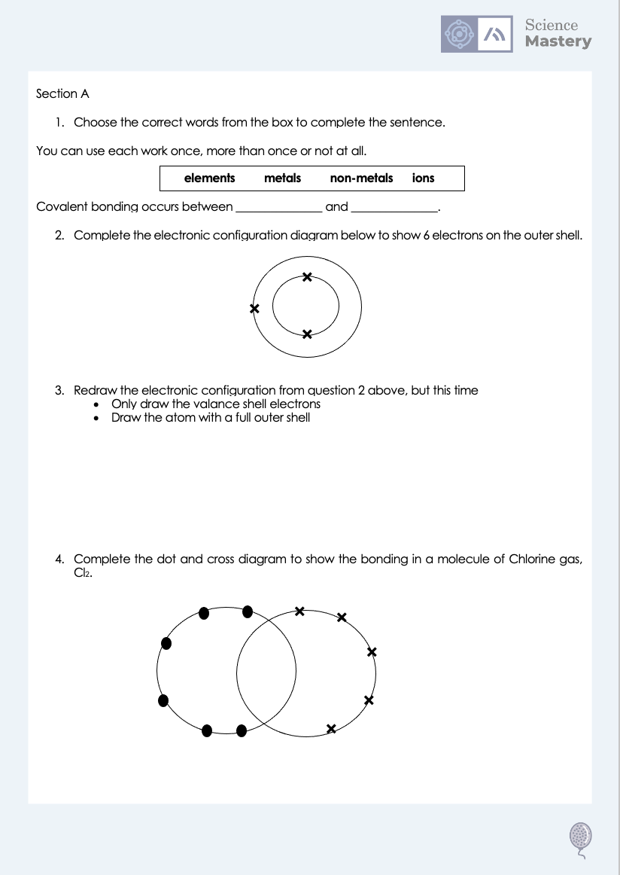
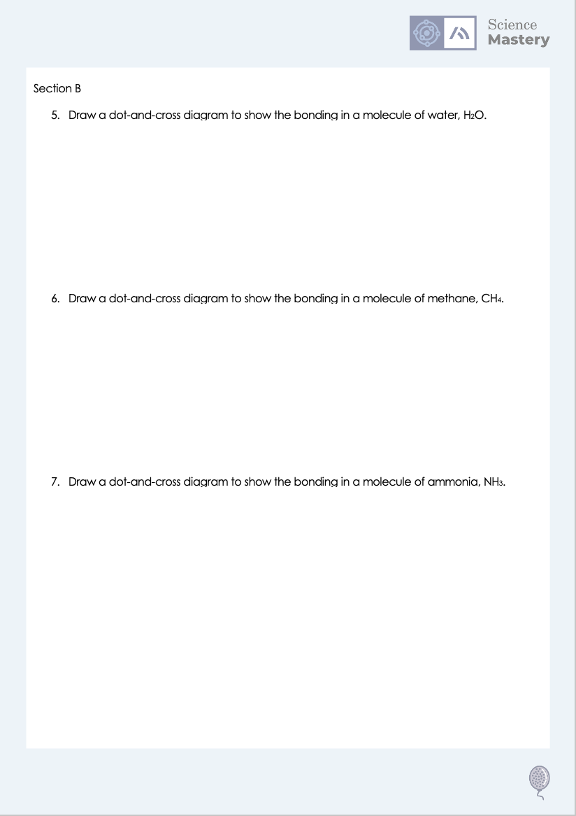
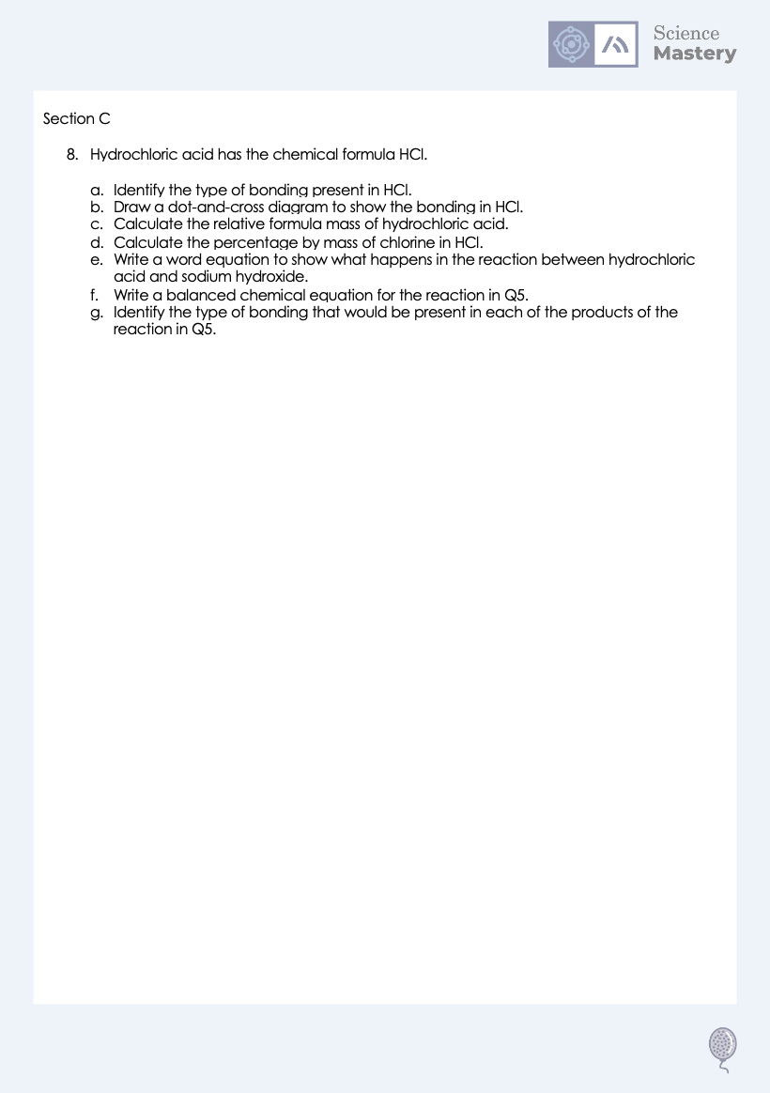
Activity

Slide 22
Answers
1. Covalent bonding occurs between non-metals and non-metals.
×
3.
×
2.
×
×
×
×
×
×
×
×
×
×
×
×
×
×
4.
×
×
×
×
×
×
×

Slide 23
Answers
5.
6.
×
×
×
×
×
×
7.
×
×
×

Slide 24
Answers
8a. Covalent bonding
8b.
×
×
×
×
×
×
×
8c. 1+35.5 = 36.5
8d. Mass of element/mass of compound x 100 = 35.5/36.5 x 100 = 97.26%
8e. Hydrochloric acid + sodium hydroxide → sodium chloride + water
8f. HCl + NaOH → NaCl + H₂O
8g. Water: covalent, sodium chloride: ionic

Slide 25
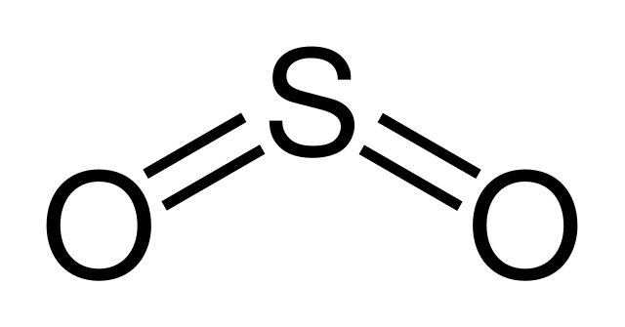
Answer the questions below.
Which answer correctly defines covalent bonding?
A. Covalent bonding occurs where two or more non-metal atoms share pairs of electrons in order to achieve a stable electronic configuration
B. Covalent bonding occurs where two or more metal atoms share pairs of electrons in order to achieve a stable electronic configuration
C. Covalent bonding occurs where electrons are transferred from one atom to another in order to achieve a stable electronic configuration
✓
2. How many pairs of electrons are shared, and how many covalent bonds are shown in this diagram?
A. 4 pairs of electrons are shared, and there are two single covalent bonds
B. 2 pairs of electrons are shared, and there are two double covalent bonds
C. 4 pairs of electrons are shared, and there are two double covalent bonds
✓
Notes:
Q1. Answer: A
If students answer B, they have mistakenly suggested that covalent bonding occurs between metal atoms instead of non-metal atoms. To fix-it, remind students that metallic and ionic bonding involve at least one metal atoms, but covalent is always involving only non-metals.
If students answer C, they have mixed up ionic bonding and covalent bonding. Model the process of each of these with dot-and-cross diagrams on the board to show the difference.
Q2. Answer: C
If students answer A, they do not recall that a double line represents a double covalent bond. If students answer B, they do not know that a double line represents 2 pairs of electrons, so two double lines represents 4 pairs of electrons in total in this molecule (1 line represents 1 pair of electrons). To fix-it, give students other examples of covalent compounds and ask them to deduce the number of electron pairs shared and the number of covalent bonds.

Slide 26
Answer the questions below.
3. Why doesn’t pure water conduct electricity?
A. It isn’t a solid
B. Pure water does conduct electricity
C. It does not contain any free electrons
✓
Notes:
Q3. Answer: C
If students answer A, they think that in order to conduct electricity, a substance must be a solid. If students answer B, they have the misconception that pure water conducts electricity (and have disregarded the property taught in this lesson in favour of this misconception). To fix-it, demonstrate an ionic solution conducting electricity with a simple circuit and lamp. To fix-it, explain that because water is a simple covalent substance it does not conduct electricity, as there are no free electrons or ions to carry the charge. Explain that water can conduct electricity if we dissolve certain substances in it, such as salt, because then we have an ionic substance dissolved and the ions can move through the liquid and carry a charge.

Slide 27
Lesson C5.1.1
What was good about this lesson? | What can we do to improve this lesson?
Send us your feedback by clicking this link
or by emailing sciencemastery@arkonline.org
Thank you!

